Slide 1
RSOOs (partnerships with Aviation Stakeholders)
Capt. Miguel Ramos
Chief, RCTP Unit – ANB
ICAO
iSASO Conference
May 20 2021

Slide 2
Benefits of regional cooperation
Shared objectives, strategies and activities
Pooling of technical resources
Regional collaboration promotes uniformity
Strengthening of safety oversight capabilities
Harmonization of laws, regulations and procedures
Promote harmonization of training
Economies of scale

Slide 3
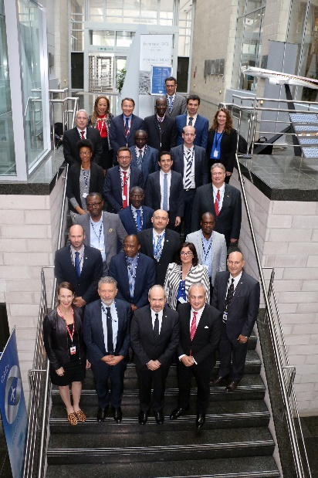
RSOO Cooperative Platform - background
RSOO Forum Swaziland March 2017
Establishment of an RSOO Cooperative Platform (iSASO a founding member)
  Facilitate exchange of information and best practices
  Training coordination and guidance material
  Interface with ICAO on topics of mutual interest for RSOOs
  Strengthen RSOO support to States

Slide 4
Benefits of being a member of the RSOO CP
Being part of a network of RSOOs, sharing common issues and solutions;
Access to best practices and guidance material, handbooks and checklists, provided by other RSOOs;
As resources are made available, assistance by the Platform or other RSOO experts on specific issues or projects and set-up/functioning of an RSOO; and
Direct interface between RSOOs and ICAO.

Slide 5

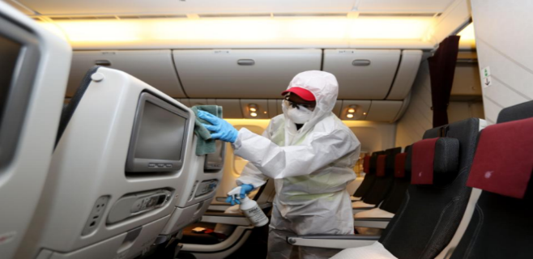
Current situation
Industry already started a gradual recovery
Fragmentation of alleviation measures in regions will undermine safe and effective mitigation strategies
An unchanged situation may lead to a slower recovery of industry
Different regions – different challenges – same goal

Slide 6
What is expected from RSOOs
A cohesive and harmonised way of restarting operations with common alleviations or restrictions in a region:
Facilitate the exchange of information on differences adopted and submitted to ICAO
Enabling a risk analysis of the region based on operational commonalities on each State
Proposals on analysis and risk mitigation implemented in the member States for restart and recovery phases

Slide 7
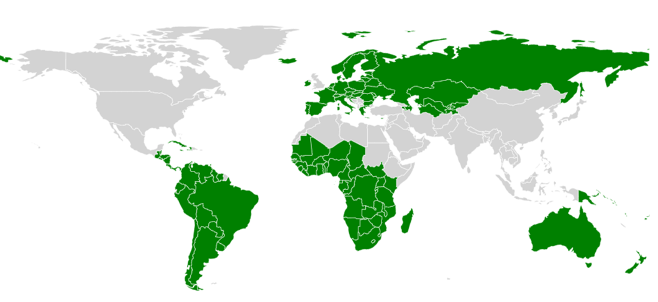
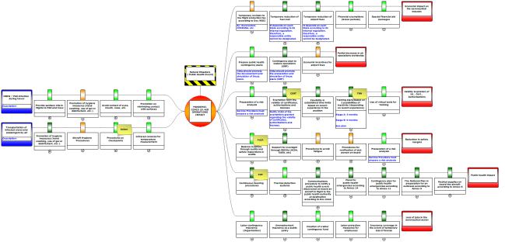
The RSOO-CP
  Actively involved in facilitating globally the information on mitigation strategies on COVID-19 that may be applicable in different regions

Slide 8
Conclusion
The flying public requires to be protected to regain confidence in the aviation system
Industry requires an effective cross sectoral coordination from all stakeholders to recover from the effects of current situation
Such coordination requires the maximum level of harmonization and flexibility to provide the necessary conditions for a safe and sustainable restart and recovery of operations even beyond an specific region of RSOOs
Fragmentation is one of the most significant impediments for this recovery and long term achievements
Interoperability among RSOOs is essential for many States to generate such conditions
ICAO RSOO CP and Regional Offices are the ideal vehicle to enable this dialog and mutual support
iSASO has a place in this joined effort

