Slide 1
SASO, the way forward for SADC
Web Conference
The Role of SADC Member States towards SASO

Slide 2
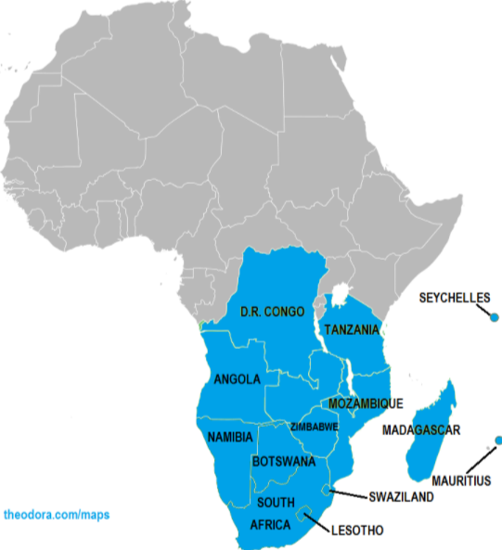
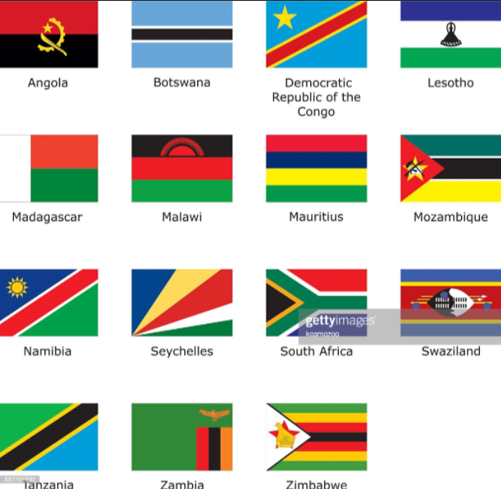
The Member States
ANGOLA
BOTSWANA
DEMOCRATIC REPUBLIC OF CONGO
ESWATINI
LESOTHO
MADAGASCAR
MALAWI
MAURITIUS
MOZAMBIQUE
NAMIBIA
SEYCHELLES
SOUTH AFRICA
TANZANIA
ZAMBIA
ZIMBABWE
MALAWI
ZAMBIA
ESWATINI

Slide 3
The Role of SADC Member States (…a recap)
Cooperation in the area of Civil Aviation Safety Oversight
Harmonization of policies and procedures on civil aviation
Fostering the development of International Civil Aviation
Give support to the Committee of Ministers,CAC and IWG
They represent and defend the interests of Member States

Slide 4
Member States roles as enshrined in the SASO Governance Structure
Executive Director
Manager Technical Support
Corporate Services
Legal Advisor
IT Specialist
Civil Aviation Committee
Ministers
Technical Coordinator(s) AIR/PEL
Technical Coordinator(s) OPS/PEL
Committee of Ministers responsible for civil aviation. Responsible for approval of:
  policies, strategies and programs of SASO;
  SASO Annual Reports submitted through the SADC Secretariat;
  proposals for amendments to the Charter;
  annual budget of the SASO;
  annual audit reports covering operations and finance;

Slide 5
Member States roles as enshrined in the SASO Governance Structure
Executive Director
Manager Technical Support
Corporate Services
Legal Advisor
IT Specialist
Civil Aviation Committee
Ministers
Technical Coordinator(s) AIR/PEL
Technical Coordinator(s) OPS/PEL
Committee of Ministers responsible for civil aviation. Responsible for approval of:
  the appointment of the experts to constitute the ad hoc committee for dispute settlement under the Charter.
  the appointment, renewal or termination of employment service of the Executive Director of the SASO;
  Committee represents Member States

Slide 6
Member States roles as enshrined in the SASO Governance Structure
Executive Director
Manager Technical Support
Corporate Services
Legal Advisor
IT Specialist
Civil Aviation Committee
Ministers
Technical Coordinator(s) AIR/PEL
Technical Coordinator(s) OPS/PEL
Civil Aviation Committee
(comprises of Director Generals of Civil Aviation Authorities from the 15 Member States of SADC.)
  Develop Policies and gives general direction…..
  recommends to Ministers for approval the organizational structure, staff service rules, policies and procedures for the SASO

Slide 7
Member States roles as enshrined in the SASO Governance Structure
Executive Director
Manager Technical Support
Corporate Services
Legal Advisor
IT Specialist
Civil Aviation Committee
Ministers
Technical Coordinator(s) AIR/PEL
Technical Coordinator(s) OPS/PEL
Civil Aviation Committee
(comprises of Director Generals of Civil Aviation Authorities from the 15 Member States of SADC.)
  recommends to Ministers for approval of the following on an annual basis
    financial structure,
    strategic plans
    Budgets and
    a formula for the contributions to be made to the approved budget by the respective Member States

Slide 8

Institutional Working Group
Comprises representatives from Member States in the fields of
    flight safety standards,
    aviation law,
    finance,
    economics,
    human capital, and
    Security
    Initially established as Flight Safety Working Group, to facilitate domestication of SADC Generic Regulations (SGRs) and SADC Generic Procedures (SGPs)
Determined to accelerate the establishment of (SASO) through:
    the review and comment on SASO operationalization documents (policies, contracts, manuals, e.t.c)
    recommendations for CAC’s approval
    recommendations to CAC on operational and strategic decision

Slide 9
Status of the SASO Chapter
9 out of 15 member state have signed the SASO Charter so far
This has resulted in delays and that are negatively impacting the full operationalization of SASO
Appeal for signing of the Charter by the remainder of SADC Member States

Slide 10


EU-AFRICA SAFETY IN AVIATION (EU-ASA PROJECT)
to enhance aviation safety in Africa
to strengthen Regional Safety Oversight Organizations (RSOOs)
assist African States to meet our obligations under the Chicago Convention to establish an effective aviation safety oversight system.
Project to assist us in moving forward, towards full operalization of SASO

Slide 11



CONCLUSION
Signing of the SASO Charter
  Remaining Member States to please sign the Charter so as to ensure full operationalization of SASO
Member State contributions
  Member States to honor their obligations
Role of Member States towards SASO
  Active participation encouraged

