Slide 1


OVERVIEW OF BAGASOO
EXPERIENCE
SASO, the way forward for SADC
WEB CONFERENCE 20 May 2021
20 May 2021

Slide 2

OVERVIEW OF BAGASOO
CONTENTS
Background
Establishment
Main Activities
Safety Tools Development
Partnerships & Technical Co-operations
Benefits to Member States
20 May 2021
Notes:
ICAO requires a permanent training record (ITS Program Guide, Section 11)

Slide 3
BACKGROUND
BAG: Banjul Accord Group emanated from (DGs meeting in 1998 of 7 W/African States to accelerate implementation of Yamoussoukro Decision - YD)
COSCAP-BAG in NOV. 2005: (Co-operative Development of Operational Safety and Continuing Airworthiness Project for the Banjul Accord Group)
20 May 2021

Slide 4
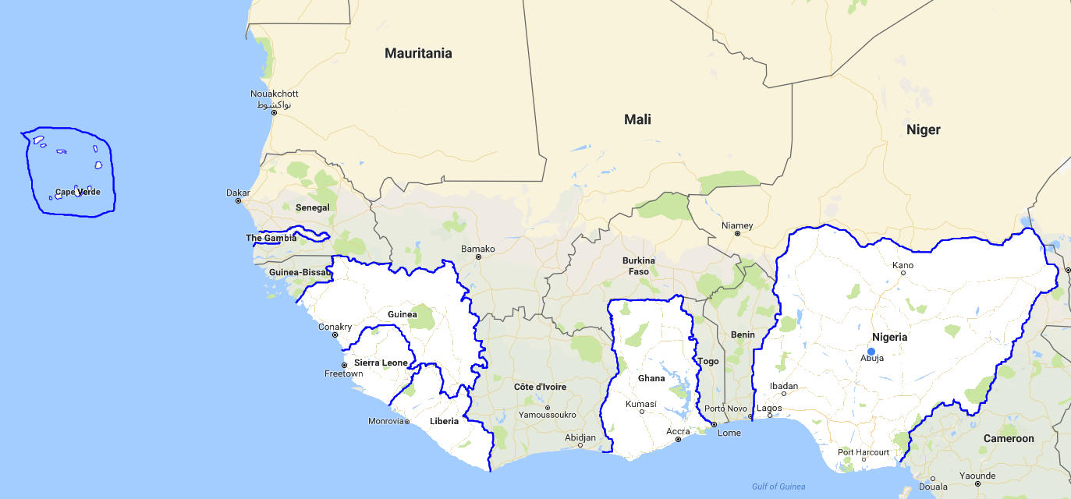
BACKGROUND cont..
Membership of 7 States in West Africa
Signing of BAGASOO Agreement & ICAO MSA in June 2009
Nigeria & Ghana largest aviation activity
20 May 2021

Slide 5
BACKGROUND cont..
KEY FACTS ABOUT THE REGION
State / Category | Population | Size (km sq.) | AOC Holders | Int/Dom. Airports
Cabo Verde | 553 000 | 4,033 | 2 | 4/3
Gambia | 2 163 000 | 11,295 | 0 | 1/0
Ghana | 29 463 000 | 238,535 | 10 | 1/4
Guinea | 13 052 000 | 245,857 | 3 | 4/3
Liberia | 4 853 000 | 111,369 | 0 | 1/1
Nigeria | 196 557 000 | 923,763 | 26 | 4/22
Sierra Leone | 7 719 000 | 71,740 | 0 | 1/0
TOTAL | 254 360 000 | 1 606,592 | 41 | 16/33
20 May 2021

Slide 6
ESTABLISHMENT OF BAGASOO
COSCAP-BAG metamorphosed to BAGASOO in 2010 (the Banjul Accord Group Aviation Safety Oversight Organisation)
Established as RSOO
Expanded scope to cover ANS (in 2015)
20 May 2021

Slide 7
ESTABLISHMENT OF BAGASOO
BAG STRUCTURE
Council of Ministers
BAG Secretariat
Board of Directors BAGASOO
20 May 2021

Slide 8
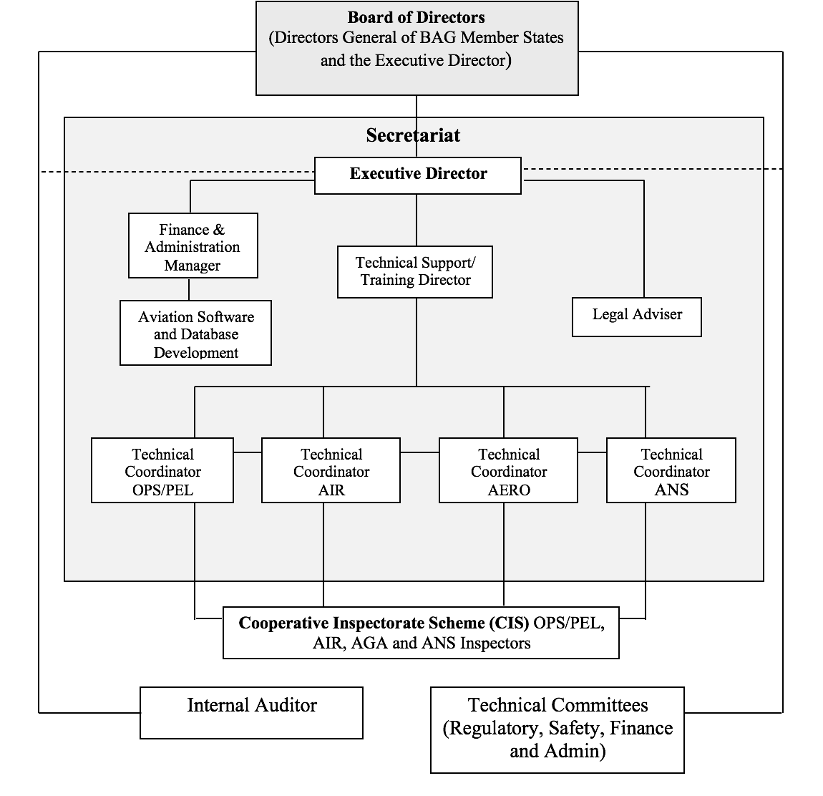
ESTABLISHMENT OF BAGASOO
ORGANOGRAM
20 May 2021

Slide 9
ESTABLISHMENT OF BAGASOO
MISSION
“To promote the highest safety standards in civil aviation within BAG member States”
VISION
“To be a world class regional safety oversight
organisation”
20 May 2021

Slide 10
ESTABLISHMENT OF BAGASOO
OBJECTIVES
Promote the safe and efficient use and development of civil aviation within and outside the Member States;
Assist Member States in meeting their safety oversight obligations and responsibilities under the Chicago Convention and its safety related Annexes and documents; and
Promote the implementation of industry best practices within the Member States as defined in the ICAO Global Aviation Safety Plan (GASP).
20 May 2021

Slide 11
ESTABLISHMENT OF BAGASOO
FUNCTIONS
Promote Harmonization
Focal point in certification and surveillance
Develop and implement a training programme
Perform certification and surveillance tasks
Conduct audits and other quality assurance activities
Develop and implement a Regional Safety Programme
Maintain relations with other RSOOs
Implement programmes that are better implemented on a sub-regional or regional basis
20 May 2021

Slide 12
ESTABLISHMENT OF BAGASOO
FUNDING
  Member State Contributions
  Support Services
  Passenger Service Levy (PSL) Introduction
20 May 2021

Slide 13
MAIN ACTIVITIES
Task Categorization/ Components
Significant Safety Concerns
Safety Capacity Enhancement
Software Development
20 May 2021

Slide 14
MAIN ACTIVITIES
Assist member States in developing operational framework and human capacity to ensure compliance with established standards through training, provision of technical documents and software applications;
Facilitates sharing of expertise, resources, and information including the transnational deployment of aviation safety inspectors in all specializations within our Member State;
Organize and co-ordinate training seminars and workshops within Member State
20 May 2021

Slide 15
SAFETY TOOLS DEVELOPMENT
Database Software Development
SIMCA Software Application
BAGASOO is developing a number of aviation database systems with the aim of ensuring the standardization of aviation activities and processes across the BAG region in a consolidated data management system.
20 May 2021

Slide 16

SAFETY TOOLS DEVELOPMENT
SIMCA
Safety Information
Management for Civil Aviation
A suite of Safety Oversight Tools
For recording and monitoring aviation activities within a CAA
Incorporates industry guidelines and best policies
20 May 2021

Slide 17



SAFETY TOOLS DEVELOPMENT
SIMCA
The SIMCA Suite of Aviation Applications is developed by BAGASOO
Documentation of Inspector Training according to the ITS
(CE-4 & 5)
Documentation of Ramp Inspections on Foreign Aircraft (CE-7)
SIMCA
Documentation and Tracking of Aviation Work Activities (CE-6,7 & 8)
20 May 2021

Slide 18
BENEFITS TO MEMBER STATES
Harmonization of the regulations within region
Uniform application of aviation safety tools software applications
  Development, implementation and training at no cost to Member States
  Regional trends, analysis and reports generation
20 May 2021

Slide 19
PARTNERSHIPS & TECHNICAL CO-OPERATIONS
  BAGASOO in collaboration with partners conducted much needed specialised Training and Workshops for it’s Member States to improve their Inspectorate Capacity over the years from:
  - FAA through Safe Skies Project of the DOT;
  - EASA under SIASA & EU-ASA Projects;
  - Airbus industry
  Cost savings from training convened within region
  African Development Bank (AfDB) grant for capacity building
20 May 2021

Slide 20
PARTNERSHIPS & TECHNICAL CO-OPERATIONS
Close Collaboration with AFCAC – Training & AFI-CIS
ICAO - AFI Aerodromes Certification Project;
  Collaboration in member States’ annual activities
  RSOO FOURM
  GASOS
  Regional Office WACAF
20 May 2021

Slide 21
PARTNERSHIPS & TECHNICAL CO-OPERATIONS
GASOS PROGRAMME
  Pilot Assessment / QMS
  ICAO Recognition
  Improved safety oversight ability leading to increase of USOAP EI of States
COLLABORATIVE PARTNERSHIPS
  collaboration is naturally established with industry and other relevant professional organizations
20 May 2021

Slide 22
BENEFITS TO MEMBER STATES
Economics of Scale
  Merging resulting to better economics -Human and Financial resources
  cost efficiencies - achieved the more efficient use of resources through delegation of functions and tasks to the RSOO
BAGASOO-CIS
  Inspector sharing scheme reducing the cost of human resources
20 May 2021

Slide 23
BENEFITS TO MEMBER STATES
CURRENT EI STATUS OF REGION
20 May 2021

Slide 24
THANK YOU
  QUESTIONS ?
20 May 2021

