Slide 1
SASO, the way forward for SADC
Web Conference

Slide 2
East African Community - Civil Aviation Safety & Security Oversight Agency
EAC – CASSOA
Emile Arao (Executive Director)

Slide 3

Contents
Introduction
Establishment of EAC – CASSOA
Strategic Direction
Conclusion

Slide 4
Introduction
The East African Community recognizes the importance of the aviation sector in achieving regional integration and accelerating economic growth and development while maintaining close collaboration and partnership with Development Partners and all Stakeholders
EAC – CASSOA as an institution of the EAC is keen to ensure that citizens who choose air transport are able to travel, or move their goods and services with much ease within the region and beyond, and enjoy a more affordable, and safe Air Transport.

Slide 5
Establishment of EAC – CASSOA
18th April 2007 EAC Council of Ministers approved the establishment of the EAC Civil Aviation Safety and Security Oversight Agency (CASSOA) as an autonomous self-accounting institution of the EAC
The Agency is established by two legal instruments, the Protocol Establishing CASSOA and the CASSOA Act

Slide 6
Establishment of EAC – CASSOA
CASSOA Mandate
Assist the Partner States in their undertaking to make air transport services safe, efficient and profitable while adopting common policies for the development of civil air transport in the region.
Mandate derived from Article 92 of the EAC Treaty (Civil Aviation and Civil Air Transport) outlines a comprehensive system of cooperation among the Partner States in civil aviation and air transport

Slide 7
Establishment of EAC – CASSOA
Principal Agency Objectives
Promote Safe, Secure and Efficient use of Civil Aviation within and outside Partner States.
Provide Partner States with appropriate forum for achieving safe and orderly development of international civil aviation.
Assist Partner States in meeting their safety and security oversight obligations under Chicago Convention and ICAO Annexes.

Slide 8
Establishment of EAC – CASSOA
Agency Membership
Membership is determined by being a party to the EAC Treaty and acceding to the Protocol
Republics of Burundi, Kenya, Rwanda, South Sudan, United Republic of Tanzania, and Uganda are the current members of CASSOA having signed or acceded to the Protocol and Treaty.

Slide 9
Establishment of EAC – CASSOA…Cont…
The organs of the Agency are:
The Board – consisting of DG’s, Aviation Expert from each Partner State and the EAC Secretary General
The Secretariat
Other organs and officers as the Board may consider necessary (Technical Committees, Working Groups, officers)
The Board reports to the Council of Ministers

Slide 10
Establishment of EAC – CASSOA…Cont…
Emphasis on Complimenting NOT Competing

Slide 11
Achievements
First region in the world implementing the State Letter on Automatic License Validation
Harmonization of regulations
Marked improvement amongst member States EI.
Construction of first Continental Centre of Aviation Medicine

Slide 12
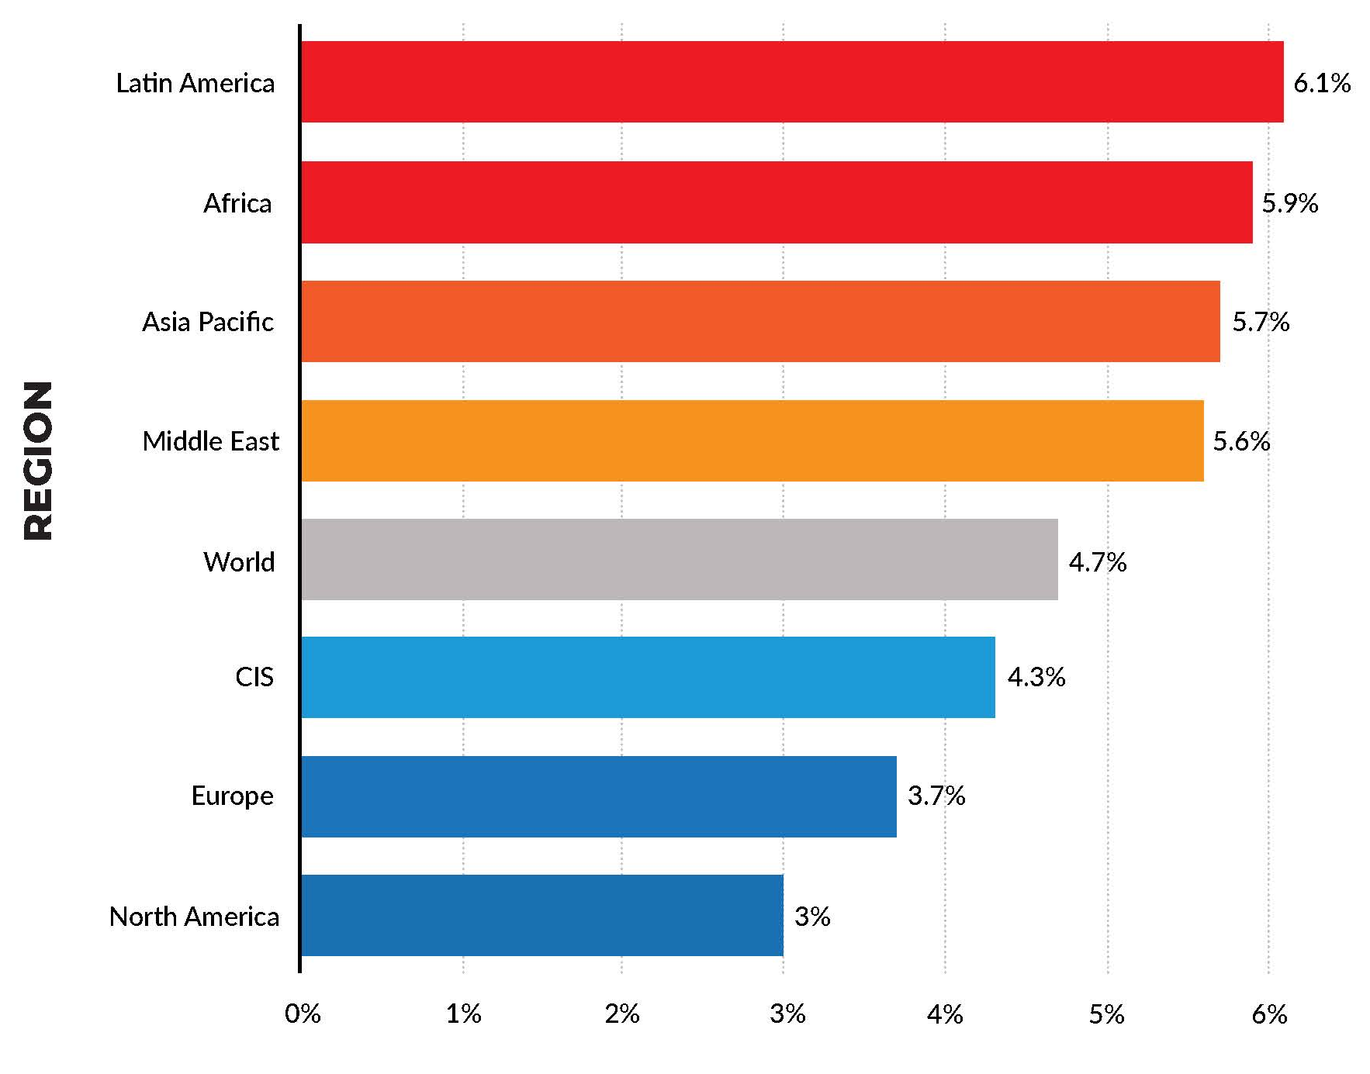
Strategic Direction
IATA 2017 study expects 7.8 global billion passengers to travel in 2036.
Prediction is based on a 3.6% average Compound Annual Growth Rate (CAGR) in IATA 20 -Year Air Passenger Forecast.
Africa will grow by a CAGR 5.9%. By 2036 it will see an extra 274 million passengers a year for a total market of 400 million passengers.

Slide 13
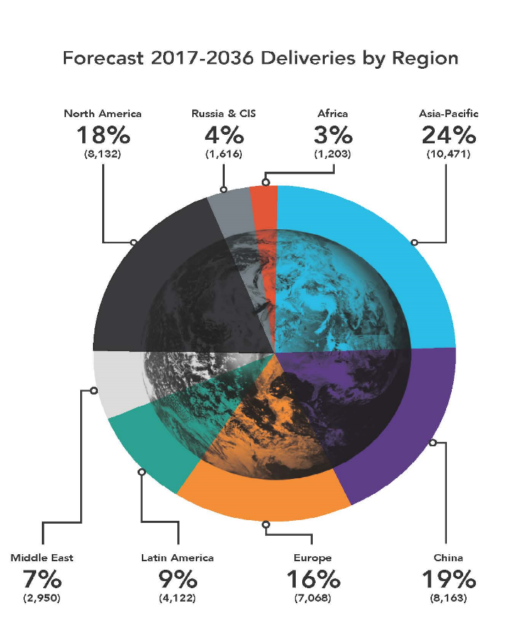
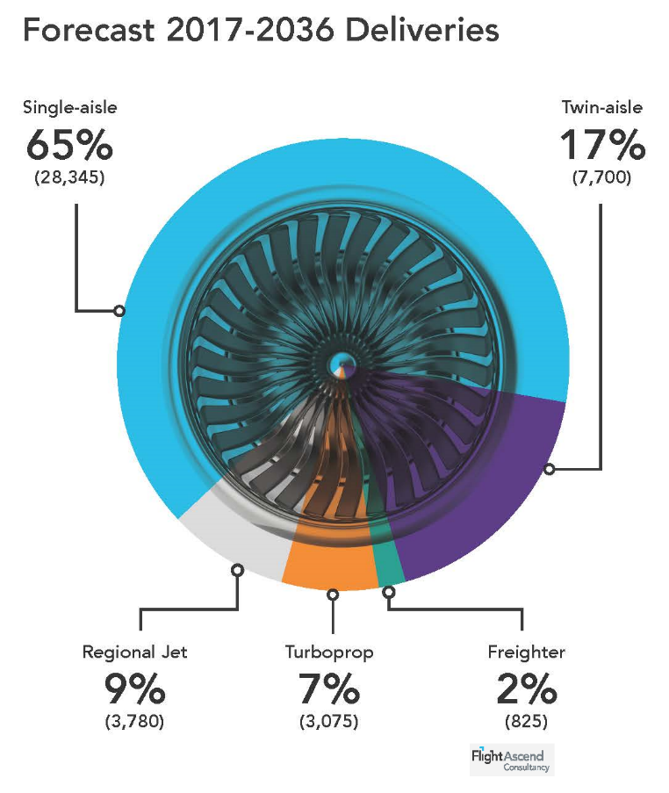
Projected Aircraft Growth

Slide 14
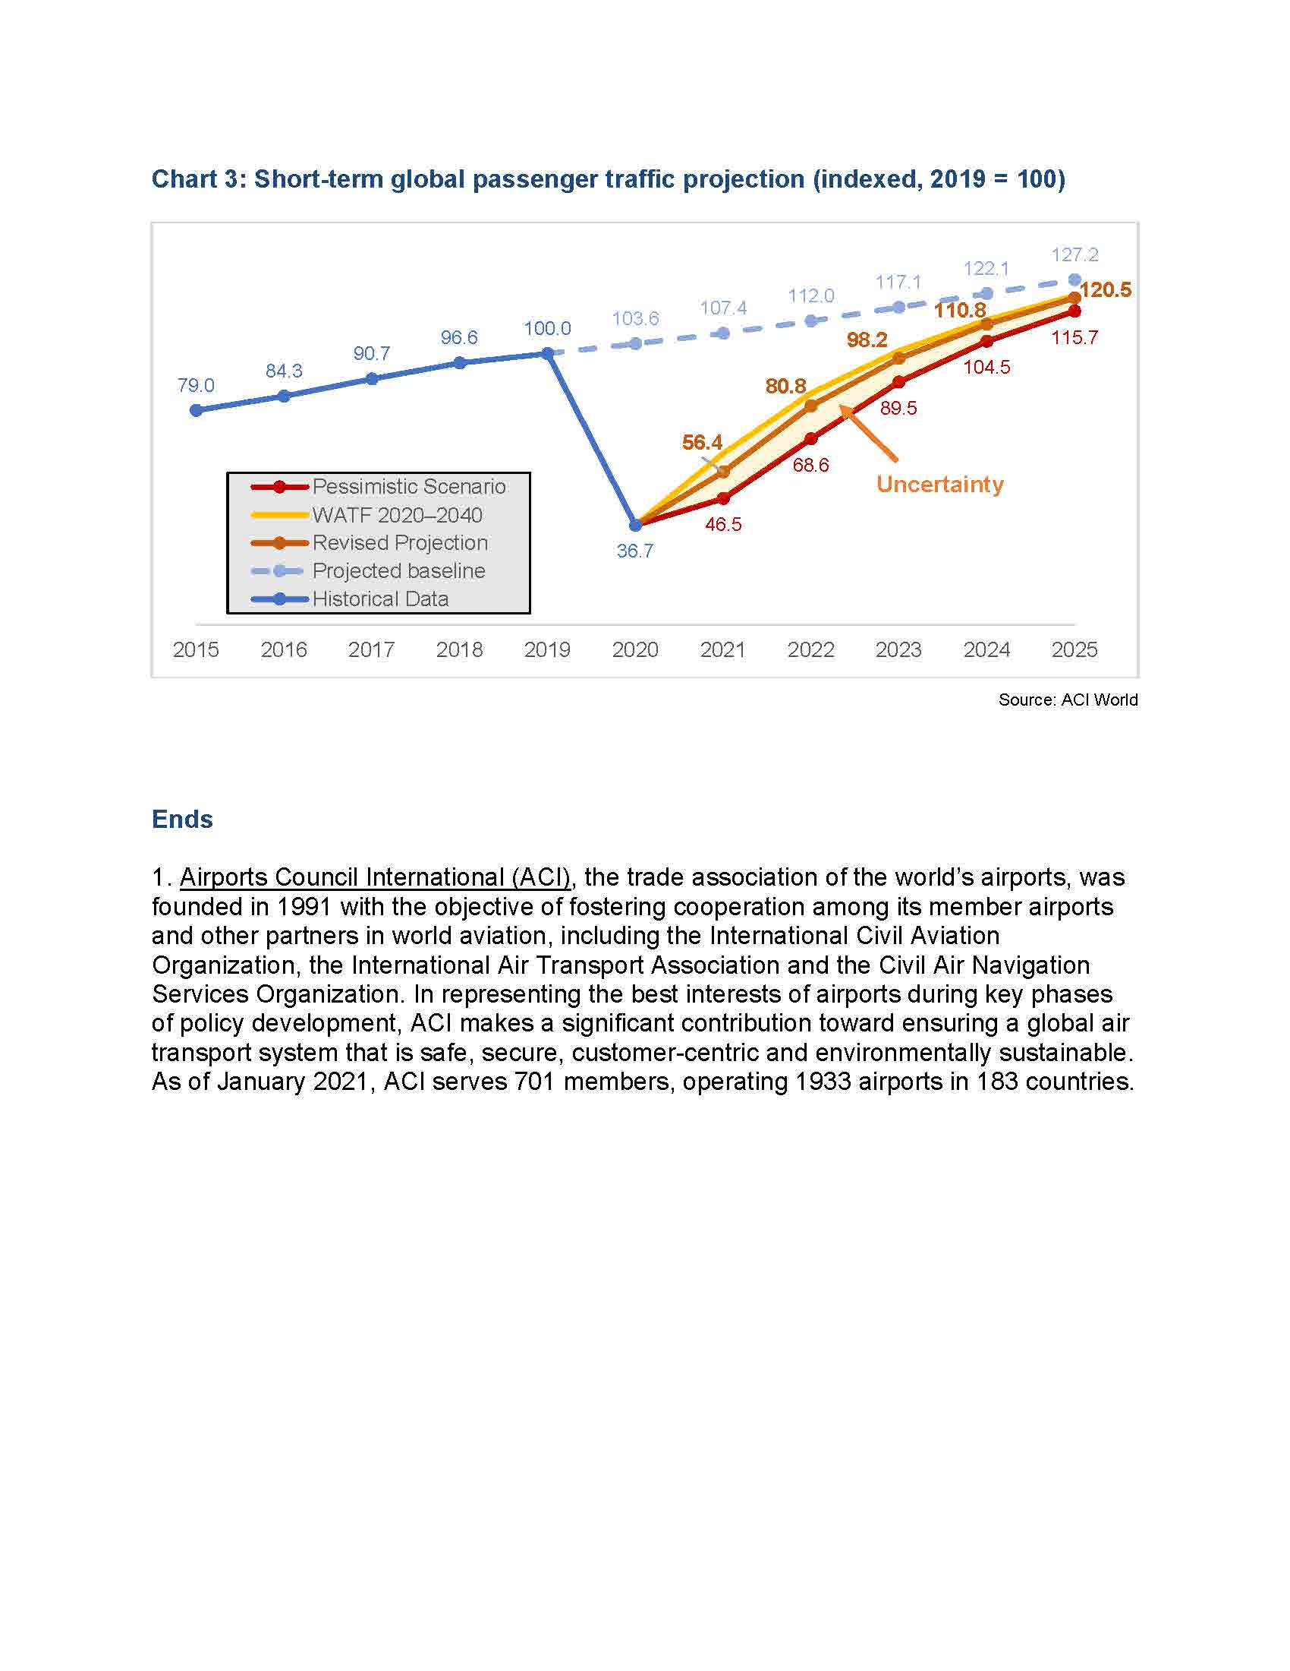
Projected Aircraft Growth
Source: ACI World

Slide 15
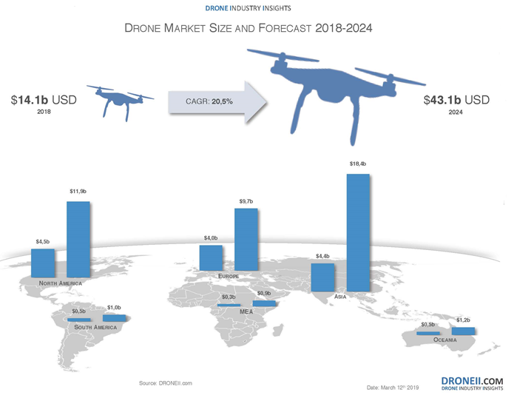
Drone Market Size and Forecast 2018 - 2024

Slide 16
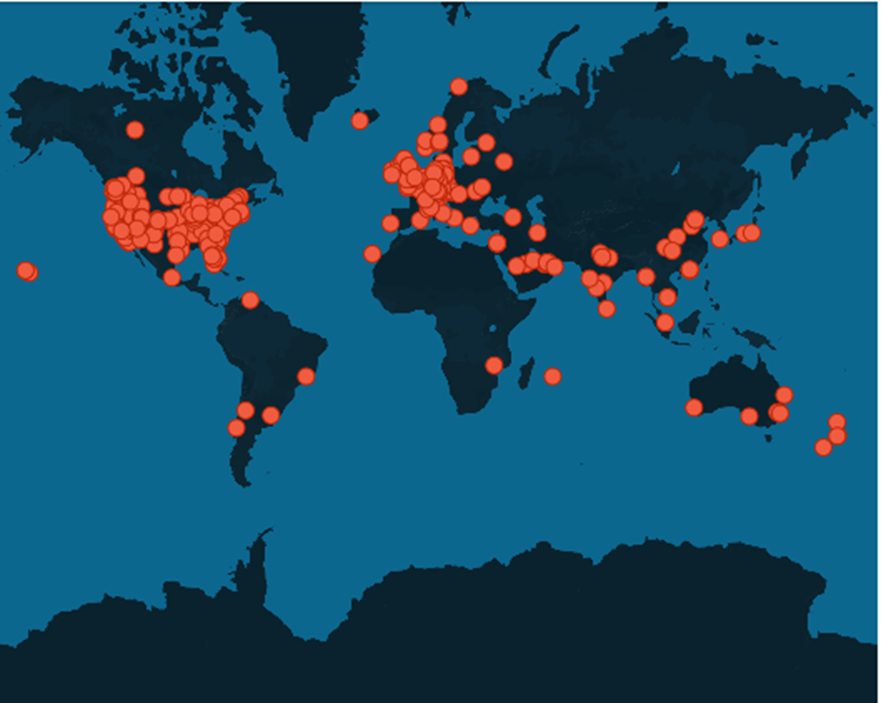
Worldwide Drone Incidents
September 17, 2019 Washington Township, PA, USA - Pa. man accused of using drone to drop explosives on ex-girlfriend’s property
May 17, 2019 Hertfordshire, UK - BA jet carrying 300 passengers from Heathrow to Abu Dhabi came within 20ft of smashing into an illegally flown drone while flying at 6,000ft shortly after take-off, report reveals

Slide 17
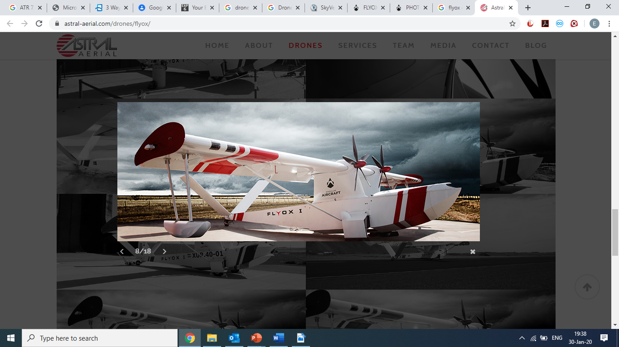
Next frontier in EAC for RPAS
Wingspan – 14 Meters
Range – 670 NM
Endurance – 6 hrs 45 mins
Max Operational Altitude – 24,000 ft
Max Weight – 4,000 Kgs
Basic Empty Weight – 2,200 Kg
Payload – 1.850 Kg
Rate of climb @ Vy – 2000 fpm
V. Cruise @75% Power – 126 Kts
V. Cruise @ 65% Power – 103 Kts

Slide 18
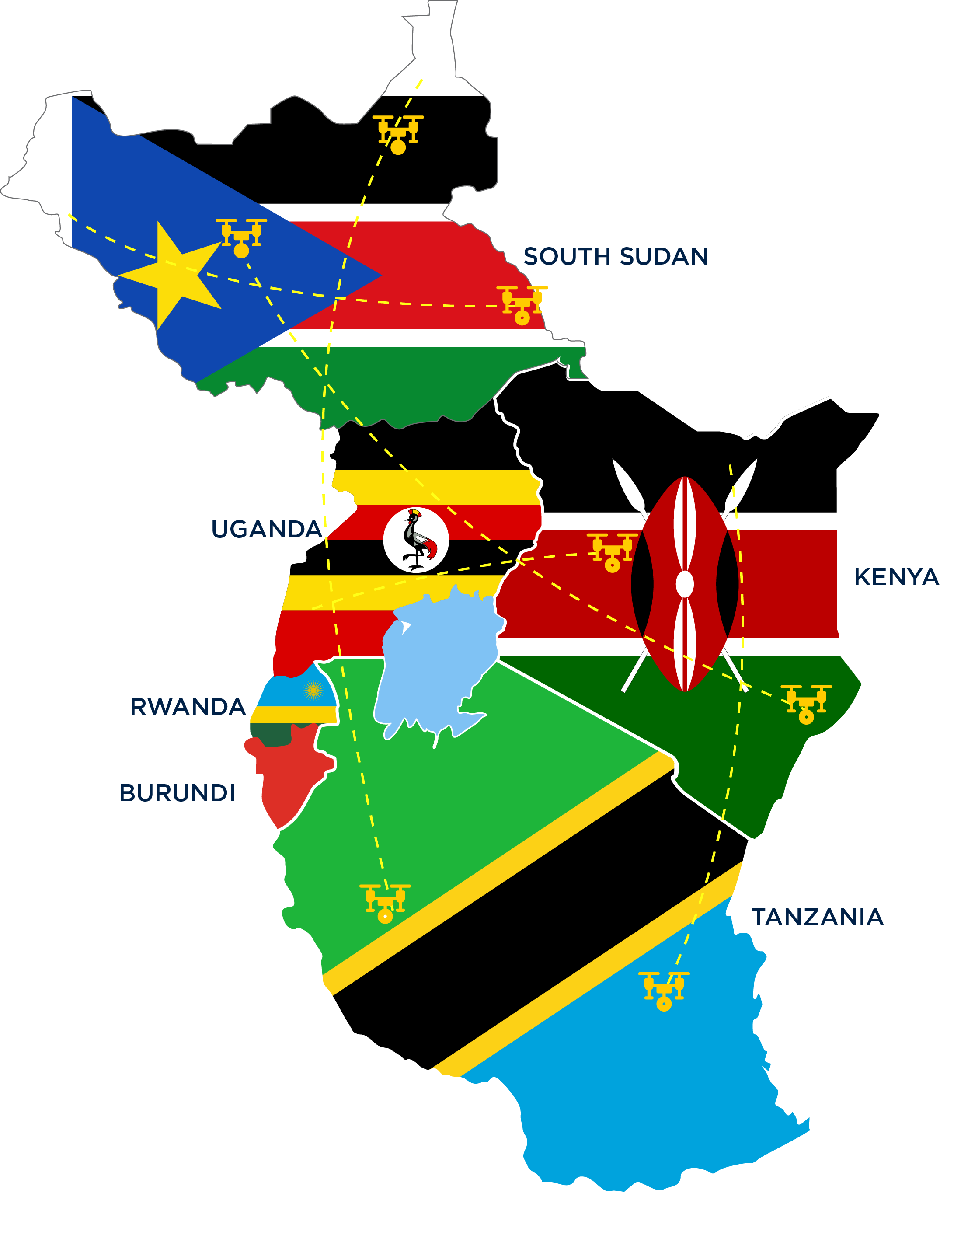
Next frontier in EAC for RPAS….Cont…

Slide 19

Conclusion
Servant Leadership
Collaboration
Cooperation
Mutual Respect
Innovation

Slide 20
Thank You !!!

